Slide 1

Topic: BIMDAS
LESSON OBJECTIVES
Use BIMDAS to answer calculations
EQ – How do we use BIMDAS?
While you are waiting,
Use maths to estimate the number of light globes in W.A. homes given the population of W.A. is about 2.5 million.

Slide 2
Topic: BIMDAS
EQ – How do we use BIMDAS?
While you are waiting,
Use maths to estimate the number of light globes in W.A. homes given the population of W.A. is about 2.5 million.
Mr Wilson’s logic
WA has about 2.5 million people in it.
There are about 4 people per family so 2.5 million ÷ 4 = 625,000
Mr Wilson’s home has about 50 lights (including fridge, oven and outside)
625,000 x 50 = 31,250,000
What do you think – which assumptions could Mr Wilson have wrong?

Slide 3
24
7
30
Topic: BIMDAS
Date
EQ – How do we use BIMDAS?
Summary

Slide 4
24
7
30
Topic: BIMDAS
Date
EQ – How do we use BIMDAS?
What are the rules of BIMDAS?
Order of Operations / BIMDAS
1. Brackets First
2. Indicies
3. Multiply and/or Divide
(from left to right)
4. Add or Subtract
(from left to right)

Slide 5

24
7
30
Topic: BIMDAS
Date
EQ – How do we use BIMDAS?
What are the rules of BIMDAS?
Order of Operations / BIMDAS
1. Brackets First
2. Indicies
3. Multiply and/or Divide
(from left to right)
4. Add or Subtract
(from left to right)
Let’s Try…
2 + $6 ×\left(4+2\right) ÷3^{2}=$
2 + $6 ×6 ÷3^{2}=$
2 + $6 ×6 ÷9=$
2 + 4 =
6

Slide 6

24
7
30
Topic: BIMDAS
Date
EQ – How do we use BIMDAS?
What are the rules of BIMDAS?
Let’s Try…
$$\left(2^{3} −\left(3−3+2\right)\right)÷3 ×4=$$
$$\left(2^{3} −2\right)÷3 ×4=$$
$$\left(8 −2\right)÷3 ×4=$$
$$6÷3 ×4=$$
8
Order of Operations / BIMDAS
1. Brackets First
2. Indicies
3. Multiply and/or Divide
(from left to right)
4. Add or Subtract
(from left to right)
Inside brackets first

Slide 7
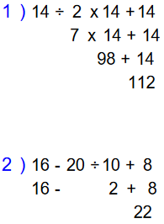
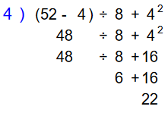
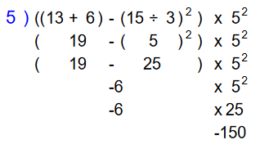
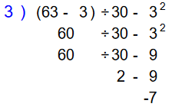
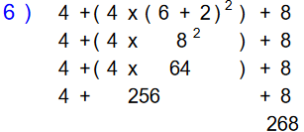

Slide 8
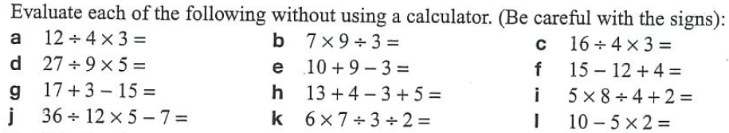

Slide 9
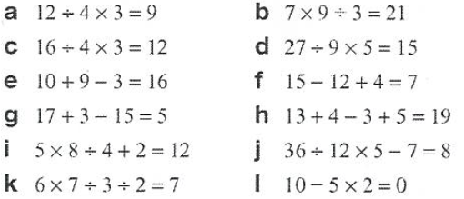
Answers

Slide 10
Exit Pass
Write your name on a piece of paper and write your answer to these 3 questions
Hand it to your teacher before you leave class.
5 – 2 + 2 x 5 ÷ 2 =
5 x (12 – 8) ÷ (4 - 2) =
2³ – (9÷3) x 2 + (8 - 3)² =

